Slide 1
help()
A Gtk GUI that provides the REPL help()
Hamilton Python Users Group
Ian Stewart
8 August 2022

Slide 2
help()
REPL - Python interactive interpreter
Read: take user input.
Eval: evaluate the input.
Print: shows the output to the user.
Loop: repeat.
$ python
Python 3.8.10 (default, Jun 22 2022, 20:18:18)
[GCC 9.4.0] on linux
Type "help", "copyright", "credits" or "license" for more information.
>>> help()

Slide 3
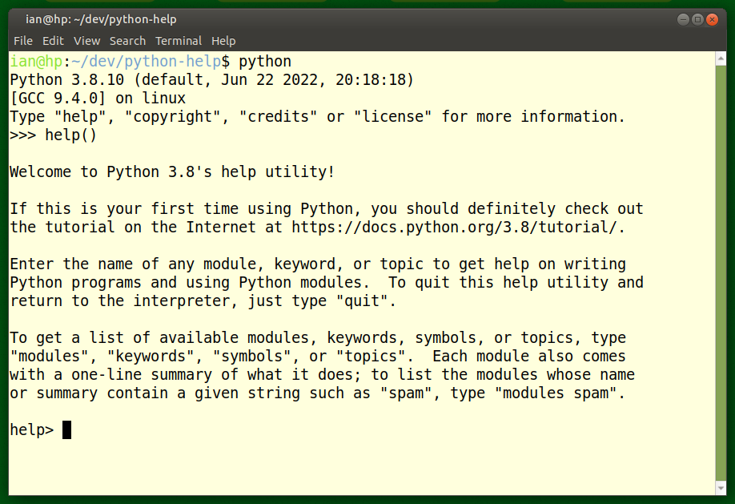
>>> help()
Help categories: Modules, Keywords, Symbols, Topics

Slide 4
Help() utility - Recommends
Tutorial: https://docs.python.org/3.8/tutorial/
Categories from which to obtaining lists of help available:
Keywords
Symbols
Topics
Modules
To quit this help utility and return to the interpreter, just type "quit".

Slide 5
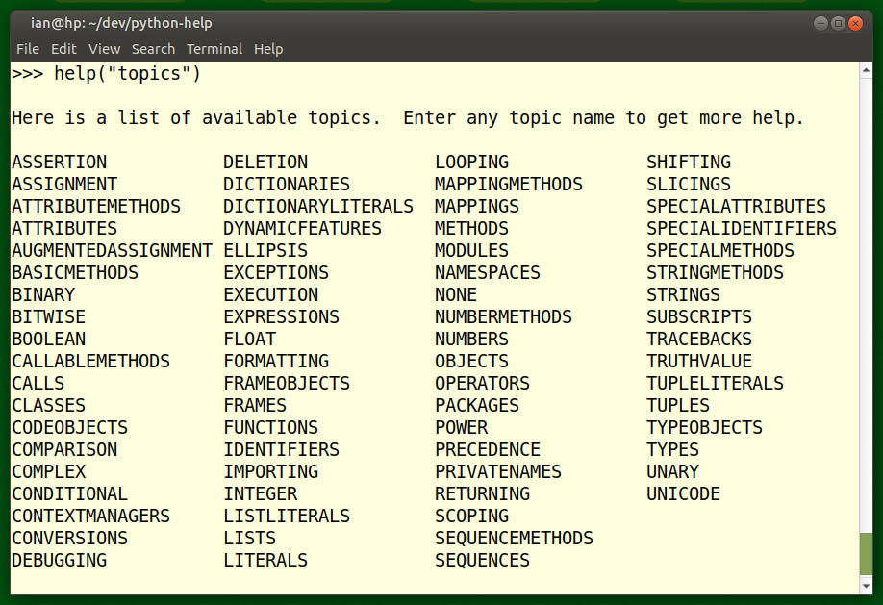
help("topics")

Slide 6
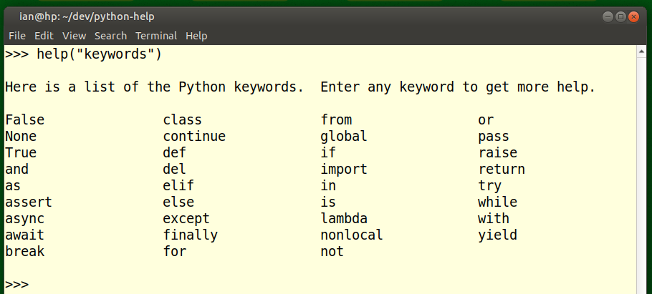
help("keywords")

Slide 7
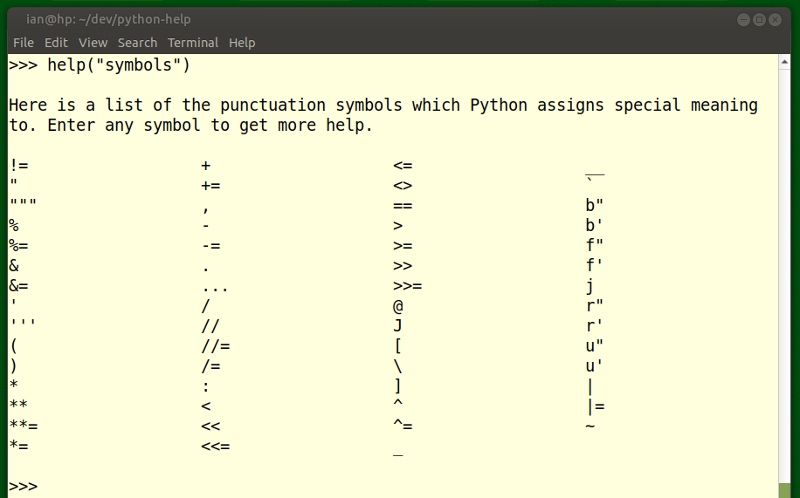
help("symbols")

Slide 8
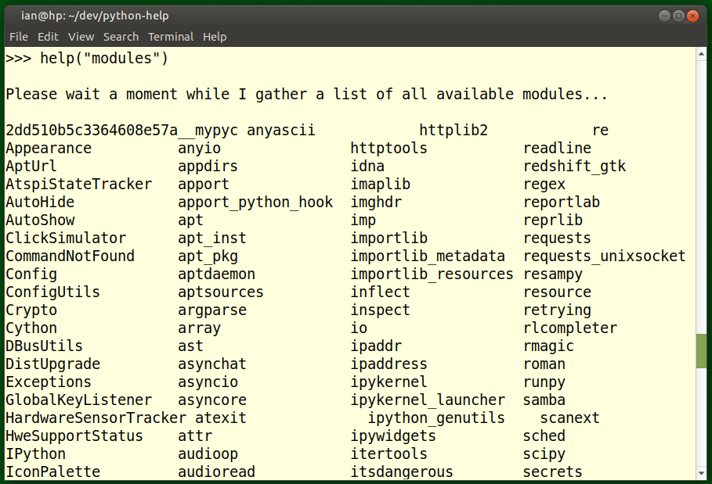
help("modules") – Beginning section...

Slide 9
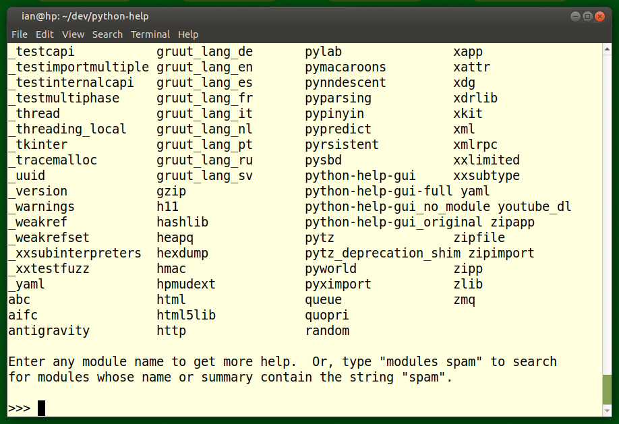
help("modules") – Ending section...

Slide 10
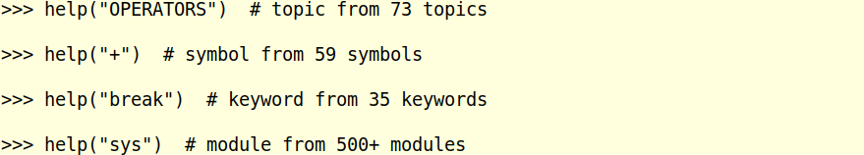
help()
Examples of obtaining Help from the four categories...

Slide 11
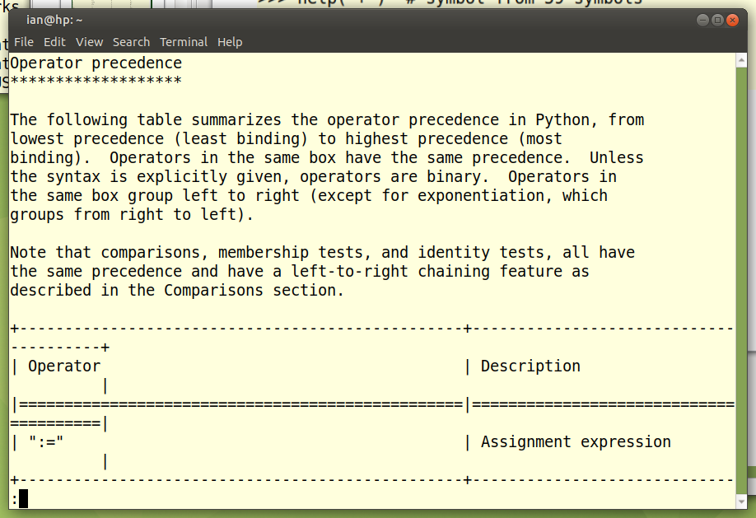
Example of help("OPERATORS") or help ("+")

Slide 12
Objective: Write a GUI help() using GTK3
Programming steps:
Get >>> help() on each of the four categories.
Output each category with its 4 column lists to a temp file.
Read back the temp file to a buffer.
Filter out pre and post amble text.
Extract the data from the four columns into a single list.
Sort the data alphabetically
Store the data in a “help” dictionary.
Launch a GTK.Window
Add a Scrolled TextView widget to display the help information
Add a Scrolled TreeView widget to display the categories.
Use a TreeStore to hold the “help” dictionary.
Link the TreeStore to the TreeView.

Slide 13
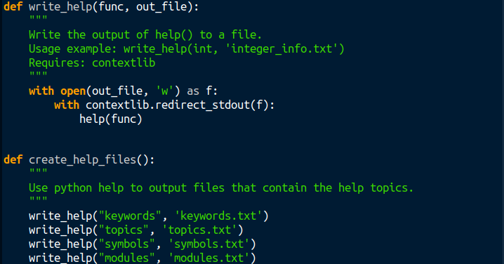
Writing a category to a temp file using the contextlib module .

Slide 14
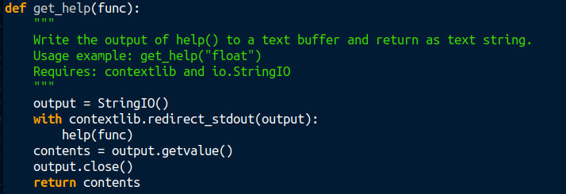
Avoiding writing to a temp file by using the io.StringIO module.

Slide 15
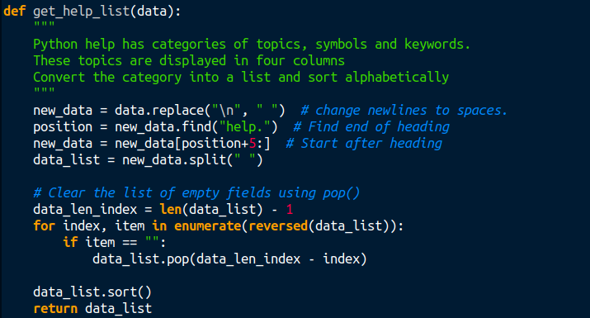
Passing the Help() category to obtain a list.

Slide 16
help()
Having obtained all the recognised help words and symbols, then they may be called. E.g.
help("+")
help("OPERATORS")
help("int")
help("sys")
… and using contextlib and io.StringIO, the information is placed in the text.buffer of TextView and is displayed.

Slide 17
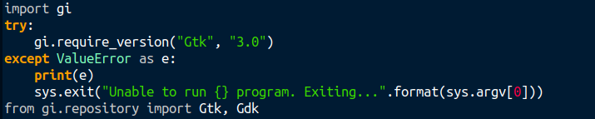
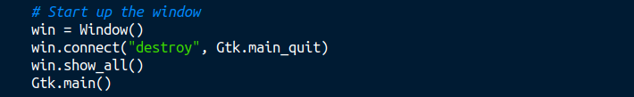
Gtk3 code. Importing and launching Window..

Slide 18
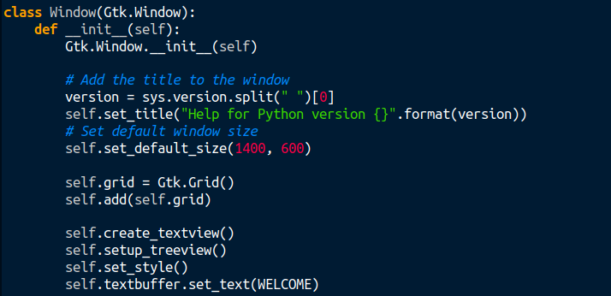
Gtk3 code. Gtk.Window being set up...

Slide 19
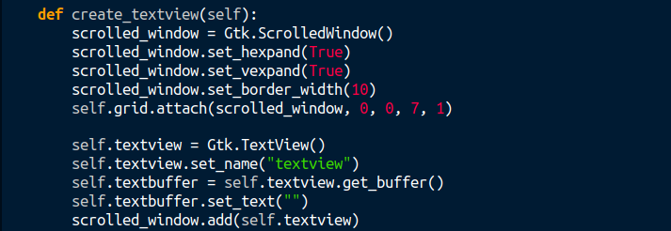
Gtk3 code. In a Gtk.ScrolledWindow add Gtk.TextView...

Slide 20
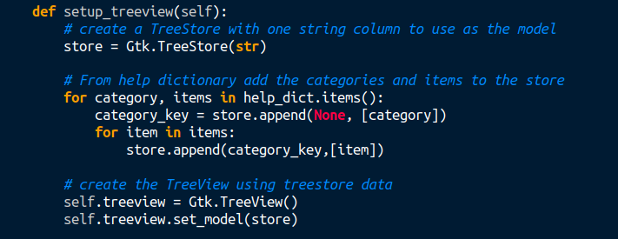
Gtk3 code. In a Gtk.TreeStore add the help() dictionary to store.
Create Gtk.TextView and get it to use the store...

Slide 21
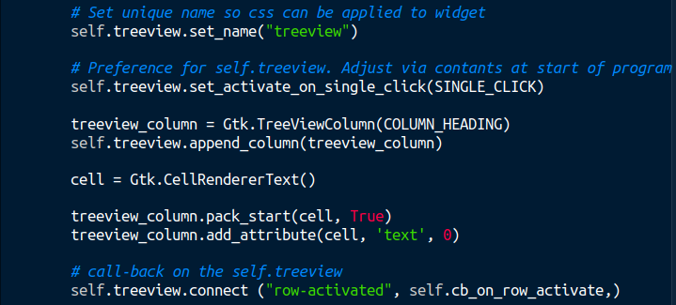
Gtk3 code. Continue setting up Gtk.TreeView

Slide 22
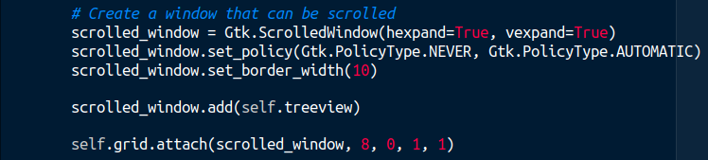
Gtk3 code. Place Gtk.TreeView in a GTK.ScrolledWindow

Slide 23
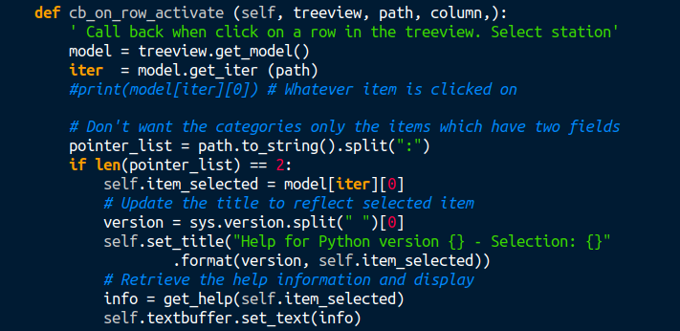
Gtk3 code. Call-back when “click” on Gtk.TreeView

Slide 24
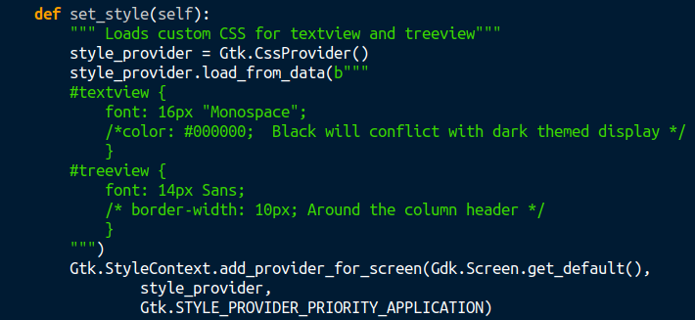
Gtk3 code. Apply CSS for fonts in Gtk.TextView and Gtk.TreeView...

Slide 25
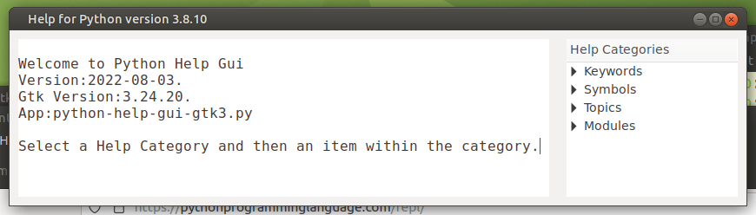
Run the program...

Slide 26
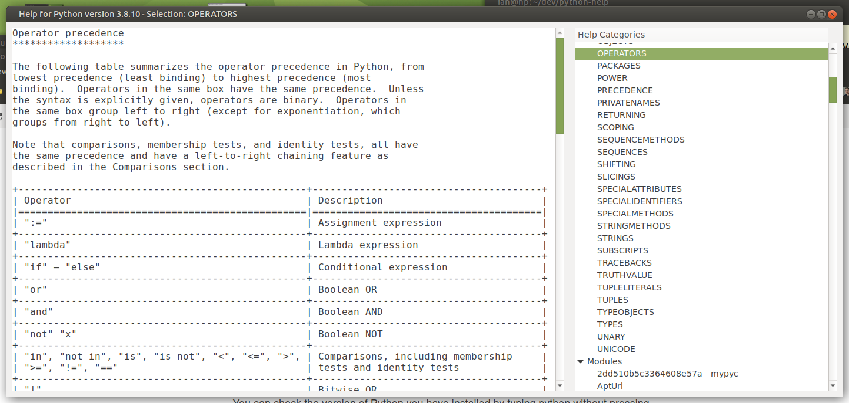
Run the program. In help category “Topics” clicked on “OPERATORS”

Slide 27
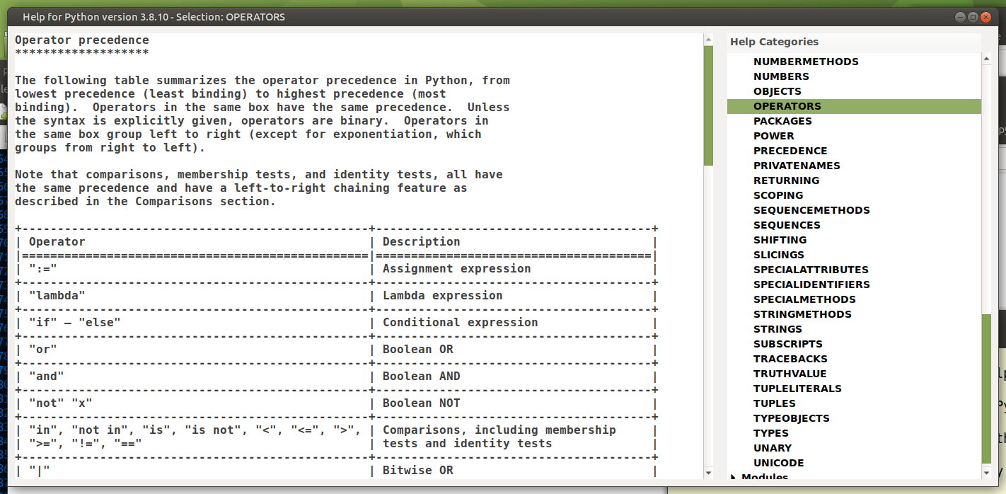
Darkened View: In help category “Topics” clicked on “OPERATORS”

Slide 28
help()
Demo Program.

Slide 29
help()
Python Observations

Slide 30
Get rid of the empty fields in the list (1/2)...
>>> a_str = "abc\nd e"
>>> a_str
'abc\nd e'
>>> print(a_str)
abc
d e
>>> a_str = a_str.replace("\n", " ")
>>> print(a_str)
abc d e
>>> a_str
'a b c d e'
>>> a_list = a_str.split(" ")
>>> a_list
['a', 'b', 'c', '', 'd', '', '', 'e']

Slide 31
Get rid of the empty fields in the list (2/2)...
>>> DATA_LEN_INDEX = len(a_list) - 1
>>> for index, item in enumerate(reversed(a_list)):
... print(index, DATA_LEN_INDEX, item)
... if item == "":
... a_list.pop(DATA_LEN_INDEX - index)
...
0 7 e
1 7
''
2 7
''
3 7 d
4 7
''
5 7 c
6 7 b
7 7 a
>>> a_list
['a', 'b', 'c', 'd', 'e']

Slide 32
Fails when length is not held at initial value...
>>>> a_str = "a b c d e"
>>> a_list = a_str.split(" ")
>>> a_list
['a', 'b', 'c', '', 'd', '', '', '', 'e']
>>> for index, item in enumerate(reversed(a_list)):
... print(len(a_list), index, item)
... if item == "":
... a_list.pop((len(a_list) - 1) - index)
...
9 0 e
9 1
''
8 2
''
7 3
''
6 4
'b'
5 5
'e'
4 6 d
4 7 c
4 8 a
>>> a_list
['a', 'c', 'd', '']
>>>

Slide 33
Iterate with list.remove() until ValueError...
>>> a_str = "a b c d e"
>>> a_list = a_str.split(" ")
>>> a_list
['a', 'b', 'c', '', 'd', '', '', '', 'e']
>>> try:
... while True:
... a_list.remove("")
... except ValueError as e:
... print(e)
...
list.remove(x): x not in list
>>> a_list
['a', 'b', 'c', 'd', 'e']
>>> # Same as remove:
>>> while True:
... x = a_list.index("")
... a_list.pop(x)

Slide 34
How a list in a dictionary is preserved as a list...
>>> a = [1,2,3,4]
>>> a
[1, 2, 3, 4]
>>> d = {}
>>> d["a-list"]=a
>>> d
{'a-list': [1, 2, 3, 4]}
>>> a
[1, 2, 3, 4]
>>> a.pop()
4
>>> a
[1, 2, 3]
>>> d
{'a-list': [1, 2, 3]}

Slide 35
List is part of dictionary...
>>> a_str = "a b c d e"
>>> a_list = a_str.split(" ")
>>> a_list
['a', 'b', 'c', 'd', 'e']
>>> a_dict = {}
>>> a_dict["a_list_key"] = a_list
>>> a_dict
{'a_list_key': ['a', 'b', 'c', 'd', 'e']}
>>> a_list.reverse()
>>> a_list
['e', 'd', 'c', 'b', 'a']
>>> a_dict
{'a_list_key': ['e', 'd', 'c', 'b', 'a']}
>>>

